Slide 1
Lecture 11 Software Engineering Agile - Scrum
Dr. Mohamed ElAraby

Slide 2
Teamwork
Software developers seldom work alone.
Several developers share an office, working on different projects or collaborating on larger projects.
Most professional software is developed by project teams that range in size from two to several hundred people.
The process of establishing requirements usually involves significant face-to-face meetings.
So software development is essentially a social activity.

Slide 3
Teamwork
Two major aspects of team activity are:
The communication between the people in the team
Deciding who does what work.

Slide 4
Teamwork
The communication problem
When two or more people are working on a piece of software, they have to communicate component specifications – component names, component functions, parameter types, and so on.
Often such interfaces are complex, perhaps involving detailed file layouts.
Always there are queries, because of the difficulty of specifying interfaces precisely.
During the lifetime of a project someone always leaves, is ill or goes on holiday. Someone has to sort out the work in their absence.
New people join the team and have to be helped to understand what the software is for, what has been done and why the structure is as it is.
They may need to learn about the standards and procedures being used on the project, or even learn a new programming language.

Slide 5
Teamwork
The communication problem
Compare the activity of picking potatoes. Imagine a large field with a relatively small number of people.
They can each get on with the job without getting in each other’s way.
If we increase the number of people, the work will get done proportionately quickly, at least until there are so many people that they are tripping each other up.

Slide 6
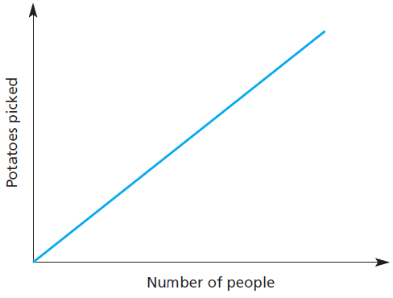
Picking potatoes

Slide 7
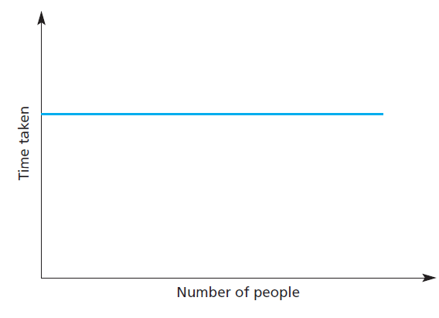
Having a baby

Slide 8
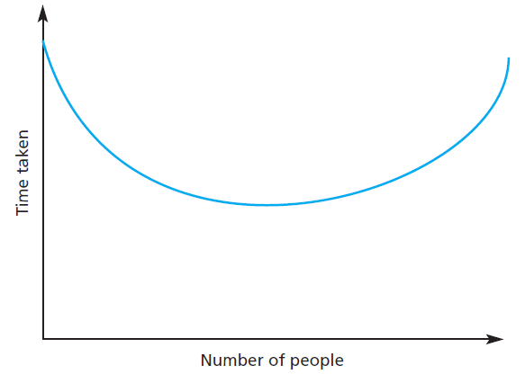
Typical software development

Slide 9
Teamwork
The division of labor
Team organization is deciding how to break down the large task into smaller tasks so that several people can carry them out.
Developers carry out a whole variety of tasks, some of which, like design, are challenging and others, like keying corrections or filing listings, are less demanding.
Division Approaches:
Dividing the work of software development amongst a set of people is to expect everyone to do a mix of tasks.
Separate out tasks that require different degrees of skill so that, for example, one person does all the design and another all the keying in of test data.

Slide 10
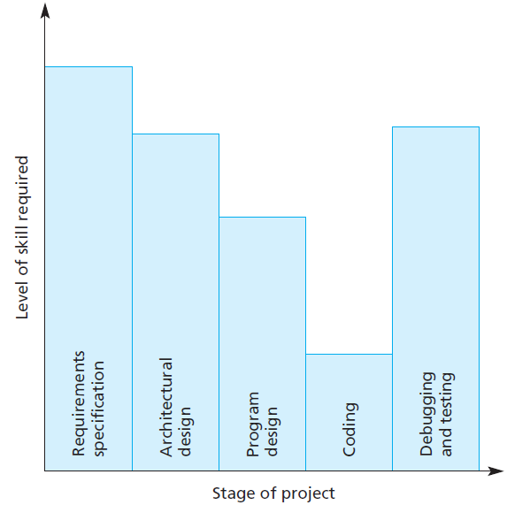
Skill requirements at each stage of a project

Slide 11
Teamwork
Creating specialist roles has several advantages:
Each person becomes an expert, highly skilled and productive at the particular task.
Greater productivity, since the team member does just one type of work and becomes very skilled at it.
Instead of paying several highly skilled people uniformly high wages, management can pay people who have different skills different salaries.
The chance to pay the different team members according to the separate skills involved in their work, rather than pay everyone at the same rate for the most highly skilled work.
Overall the wages of the people with unequal skills will be lower than those of the skilled people. Thus the wages bill is reduced.
To give a crude example, it would be cheaper to employ a programmer at $50,000 and a designer at $100,000, rather than employ two designer/programmers each at $180,000. It is no coincidence that Charles Babbage, one of the founding fathers of computing, was well aware of this effect.

Slide 12
Teamwork
The benefits of creating a cohesive group are:
The group can establish its own quality standards Because these standards are established by consensus, they are more likely to be observed than external standards imposed on the group.
Individuals learn from and support each other People in the group learn from each other. Inhibitions caused by ignorance are minimized as mutual learning is encouraged.
Knowledge is shared Continuity can be maintained if a group member leaves. Others in the group can take over critical tasks and ensure that the project is not unduly disrupted.
Refactoring and continual improvement is encouraged Group members work collectively to deliver high-quality results and fix problems, irrespective of the individuals who originally created the design or program.

Slide 13
Any Question?

